Slide 1

FATE versus FREE WILL
In Ernest Hemingway’s The Old Man and the Sea

Slide 2
01
Introduction
What is Fate
What is Free Will
Impact of Fate and Free Will on Santiago
Trainee’s Name:Md. Isfak Ali
Trainee’s Id : IS-01-24

Slide 3
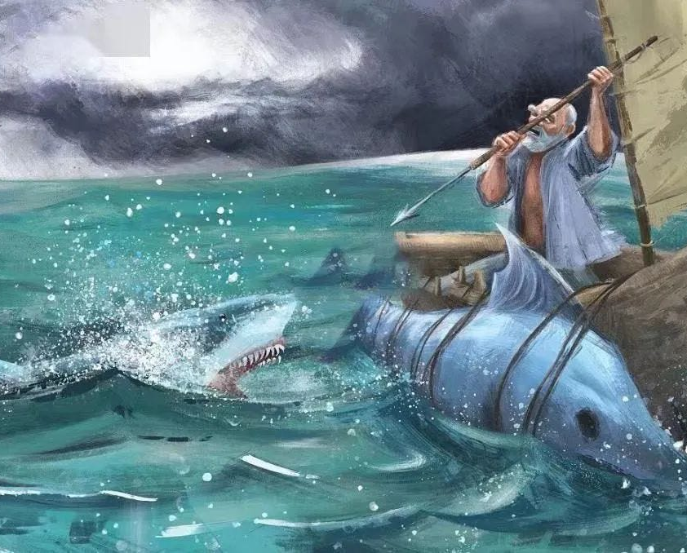
Fate
The idea that events in our lives are predetermined and out of our control.

Slide 4
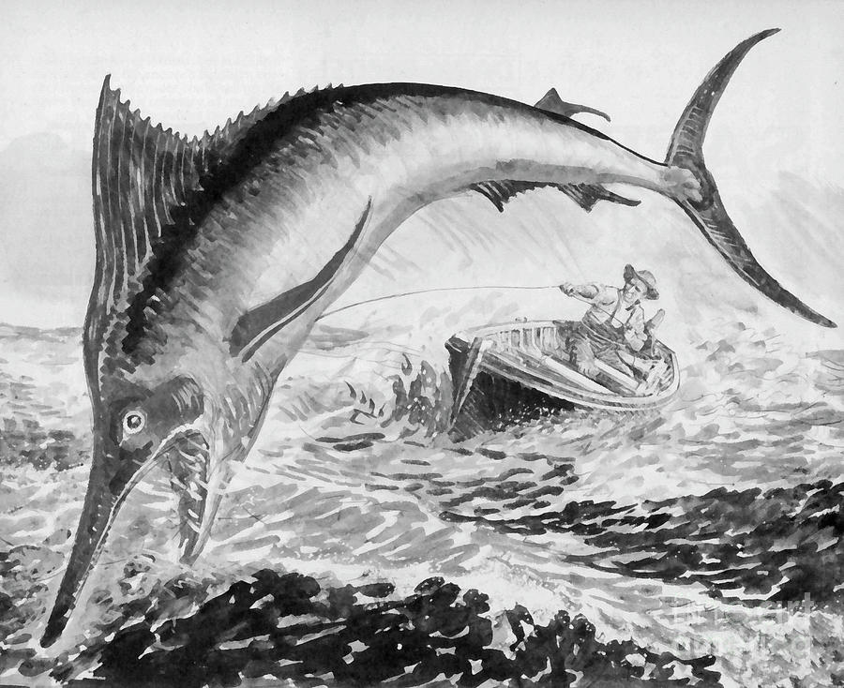
Free Will
The ability to say yes when yes is needed, to say no when no is needed and sometimes to keep quiet when nothing is needed.

Slide 5
Free Will
Fate
Impact of Fate and Free Will on Santiago
Capturing the marlin against all odds through strong willpower
Losing the Marlin in shark attacks

Slide 6
02
FREE WILL
Santiago’s Journey: A testament to Free Will
Confronting Natural Adversities with Free Will
Acceptance vs Resistance
Santiago’s Free Will and Philosophic Theory

Slide 7
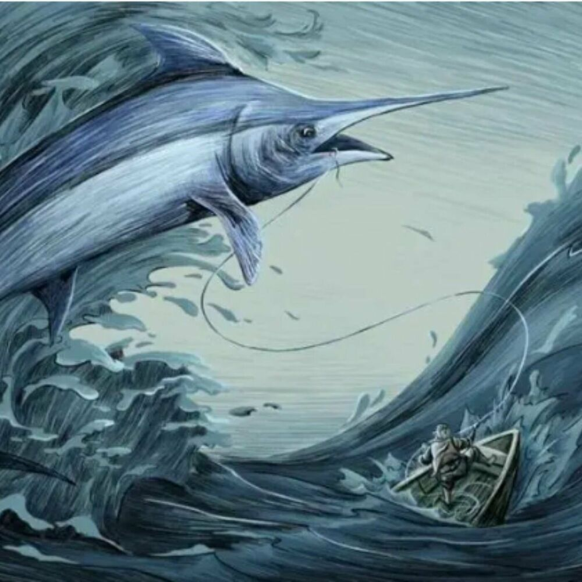
Santiago's Journey: A Testament to Free Will
Sources Of Santiago's inspiration:
His Sense of Pride
The Challenge of Marlin
Indomitable Spirit
Desire to Reclaim Past Glory

Slide 8
1.Confronting natural adversities with free will
Free will allows individuals to choose how to react to adversities. While we cannot control natural disasters or illness, we can decide how we face these events.
2.Acceptance versus resistance
Sometimes, free will is demonstrated in the decision to accept rather than resist. The ability to choose to accept hardship, like suffering, is another form of freewill

Slide 9
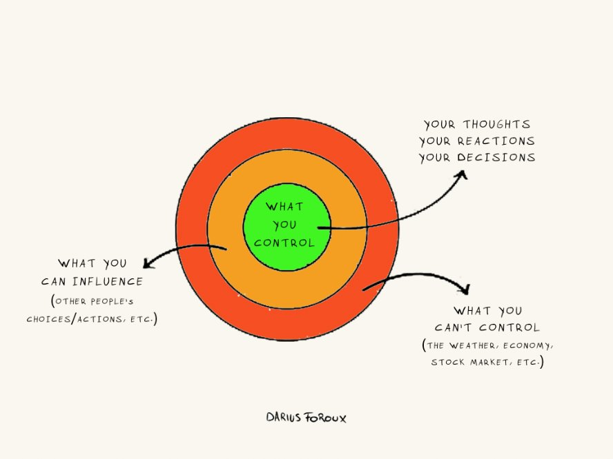
Santiago's freewill and philosophical theory
Stoicism
It emphasizes accepting things that cannot be controlled and focusing on how one responds to them.

Slide 10
03
Fate
Santiago’s Relationship with Luck
Natural Forces
Santiago’s Response to Fate

Slide 11
Fate
The idea that events in our lives are predetermined and out of our control.

Slide 12
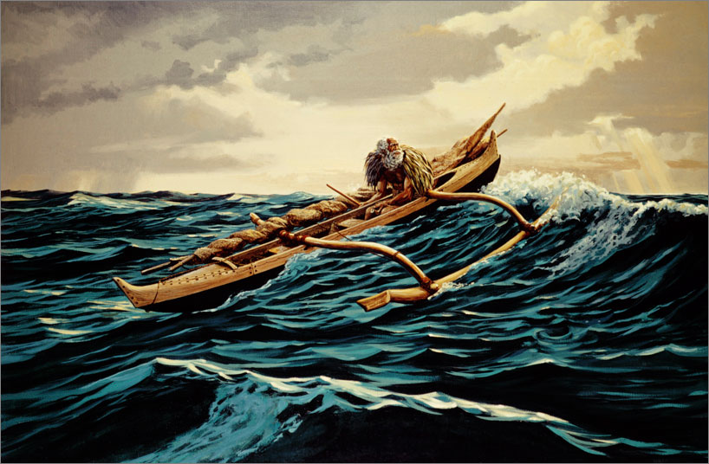
Santiago’s Relationship with Luck
Viewed as an unlucky fisherman who
hasn’t caught a fish in 84 days
Goes to the sea everyday hoping for luck
to turn
His catching of the marlin gives the
Impression that his luck has turned

Slide 13
Santiago’s Relationship with Luck
“It is better to be lucky. But I would rather be exact”

Slide 14
The Sea
Natural Forces
> Giver and a taker of life
>Reflects the unpredictable nature of life
>Provides opportunities
>Presents immense challenges

Slide 15
The Marlin
Natural Forces
The great marlin symbolizes nature’s majesty, resilience, and human aspiration for greatness

Slide 16
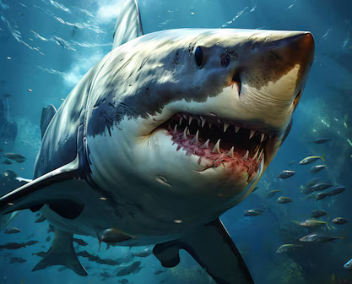
The Sharks
Natural Forces
The sharks highlight the harsh reality of existence, the fragility of human achievement, and the inevitability of loss

Slide 17
Santiago’s Response to Fate
He faces fate with courage, skill and
unyielding determination.
“A man can be destroyed
but not defeated”

Slide 18
04
Interconnections
Free Will Moulds Fate
Free Will is Predetermined
Limitations of Free Agents
Fate vs. Free Will: Which Triumps

Slide 19
Free Will
The ability to say yes when yes is needed, to say no when no is needed and sometimes to keep quiet when nothing is needed.

Slide 20
Plan
Free will moulds Fate
“What is his plan? What is mine?”
An attempt to predetermine destiny
Persistence
“You tried to buy luck with nearly 84 days at the sea. They nearly sold you that too”

Slide 21
Free will is pre-determined
“My choice was to go there and find him beyond all people”
Psychological Determinism
Our actions are automatically elicited by a combination of our psychological states, such as desires and character traits

Slide 22
Limitations of Free Agents
Knowledge
Skill & Experience
Physiology
“I wish the boy were here”
“I wish it were a dream and I had never hooked him”
“It is better to be lucky but I’d rather be exact”
“He could ruin me by jumping or by a wild rush”
“Why was I not born with two good hands”
“Everything about him was old except his eyes”

Slide 23
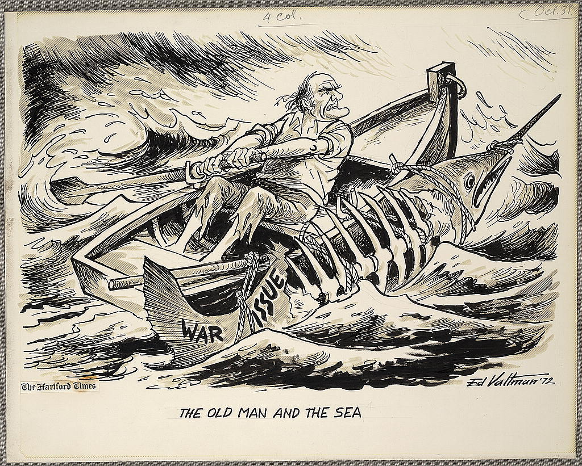
> Initial victory of skill, patience and technique > Santiago knows his capabilities > Fate as a teacher > Room for hope for the future
Fate vs. Free Will: Which Triumphs

Slide 24
05
Conclusion
Life (Fate +Free Will)
Fight for Goals
Never Give Up
Final Message

Slide 25
Lesson 1
Life is shaped by a combination of choices and uncontrollable forces
Life (Fate + Free Will)

Slide 26
Lesson 2
Santiago’s journey inspires persistence and dedication to aspirations
Fight for Goals

Slide 27
Lesson 3
Resilience in the face of challenges defines the strength of the human spirit
Never Give Up

Slide 28
Lesson 4
Never giving up hope in the face of challenges defines the strength of the human spirit
Never Give Hope

Slide 29
Lesson 5
Santiago’s story serves as a reminder to embrace both free will and fate, fight for what we believe in, and persevere through life’s adversities.
Final Message

Slide 30
THANK YOU.

